Slide 1


*Any reference made to commercial products or services during the course of this presentation is not, and should not be construed as, an endorsement or Government sanction of those products or services*
Government Use of Social Media: Opportunities & Challenges
Chris Swartz, OGE/ Justin Herman, GSA

Slide 2

Social Media (noun):
An umbrella term referring to internet-based services that permit users to create, share, re-purpose and publish informational content.
Social media websites require users to affirmatively join, and typically require users to create a uniquely identifiable profile.
Examples include, but are not limited to, Facebook, Twitter, LinkedIn, Wikis, and Google+.
Jodi Cramer, Erica Dornburg & Nancy Eyl, Government Ethics and the Use of Social Media,
2014 Office of Government Ethics Conference, available at http://www.oge.gov/Education/National-Government-Ethics-Conference/National-Government-Ethics-Summit/Sessions/Forum-1/Government-Ethics-and-the-Use-of-Social-Media/

Slide 3
“A new technology does not add or subtract from something. It changes everything.”
-Neil Postman, Technopoly (1992)

Slide 4
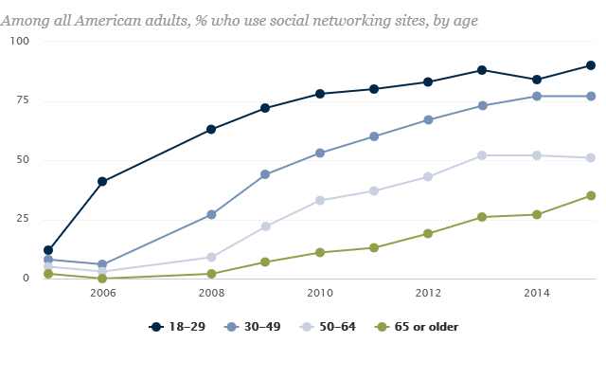
Social Media Use is Rising
Social Media usage 2015:
90% of adults 18-29 yrs.
77% of adults 30-49 yrs.
51% of adults 50-64 yrs.
52% of online adults use multiple Social Media sites
70% of Facebook users engage daily
45% of Facebook users engage multiple times per day
Duggan, M., Ellison, et. al. “Social Media Update 2014,” Pew Research Center, January 2015. Available at: http://www.pewinternet.org/2015/01/09/social-media-update-2014
Andrew Perrin. “Social Networking Usage: 2005-2015.” Pew Research Center. October 2015. Available at: http://www.pewinternet.org/2015/10/08/2015/Social-Networking-Usage-2005-2015/

Slide 5

Important Characteristics of Social Media Technology
Communicative in Nature
Easy to Generate Content
Easy to Share & Re-share Information
High Speed
Widely Accessible
Low Resource/Cost Investment
Multimedia (photographic, text, video)
Long Data-Retention
Informal/Conversational

Slide 6
Communication Style & Characteristics
Traditional Written
Permanent or Semi-permanent
Formal
Lacks responsiveness
Less emotional
Costly in time and resources to create
Rigid
Unlikely to be distorted
Social Media
Permanent or Semi-permanent
Informal
Responsive
Can include emotional appeal
Low cost in time and resources
Somewhat flexible
Potential for distortion
Traditional Verbal
Not Permanent
Informal
Highly Responsive
Can Include emotional appeal
Low cost in time and resources
Flexible
Potential for distortion
Based on http://thebusinesscommunication.com/difference-between-oral-and-written-communication/

Slide 7
Communication Expectations:
In- Person Communication
In Person Communication:
We focus our communications on a specific audience.
If done in public, expectation of being “overheard” by bystanders.
S
L
L
S
L
L
L
S
L
L
L
See e.g., Erving Goffman, Forms of Talk (1981)

Slide 8
Communication Expectations: Technology-Based Communication
Isolated Two-way Communication
Telephone:
Email:
Text (SMS) Message
Dispersed One-Way Communication
Books/Publications-Television- Radio-Static Website
S
L
L
                up to ∞
S
S
L
L
                up to ∞
S
L
Notes:
Because it is expected that a wide audience will view/hear,
It is expected that you communicatie wit that in mind.

Slide 9
Communication Expectations:
Social Media Communications
Dispersed Two-way Communications
While we often focus on an limited audience, communications are dispersed and generally accessible by a large number of people.
Unlike other dispersed communications (e.g. television), our audience, intended and inadvertent can respond.
L
                up to ∞
S
L
                up to ∞
Often we expect that communications will be somewhat private although they are not.

Slide 10
Social Media Identity:
Blurring of Personal & Official
Official
Personal
Separation of identities becomes increasingly hard in the digital-age
Social media allows users to present integrated identities, blurring the distinction between official & personal
Communications on social media, whether in personal capacity or official, can effect public’s view of individual in professional capacity
Attribution issues may arise
See, e.g., Matthew DeCamp, et. al., Social Media and Physicians’ Online Identity Crisis, 310 J. Am. Med. Assoc. 581 (2013).

Slide 11
Social Media Identity:
Blurring of Personal & Official
Private
Public
Depending on the circumstances, statements may be mistaken for being official (if personal) or personal (if official).
Key:
- Personal Letter
- Official Publication
- Official Phone Call
★ - Personal Social Media Statement
- Official Social Media Statement
Personal
Official

Slide 12
Opportunities

Slide 13


Slide 14
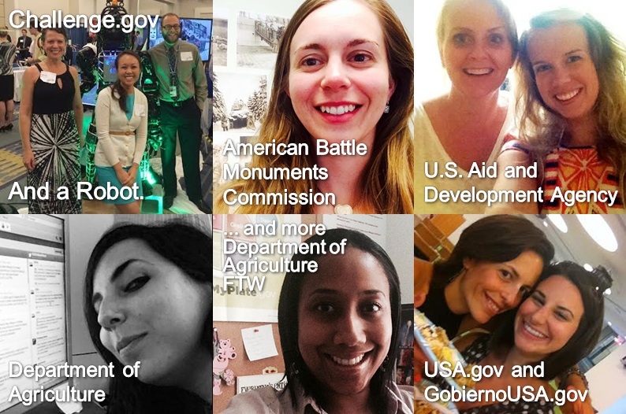
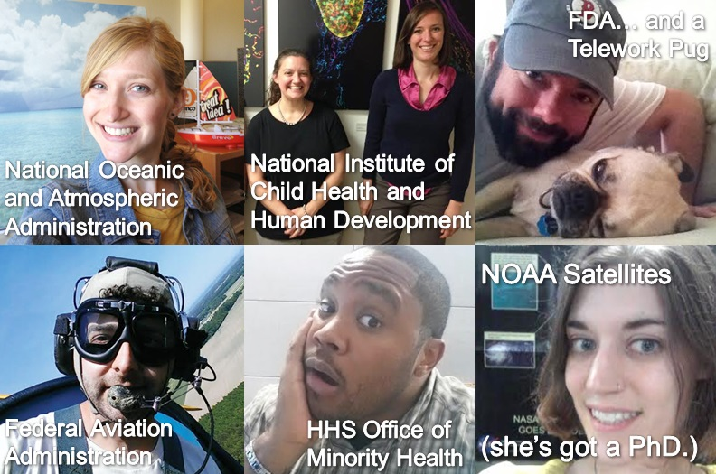
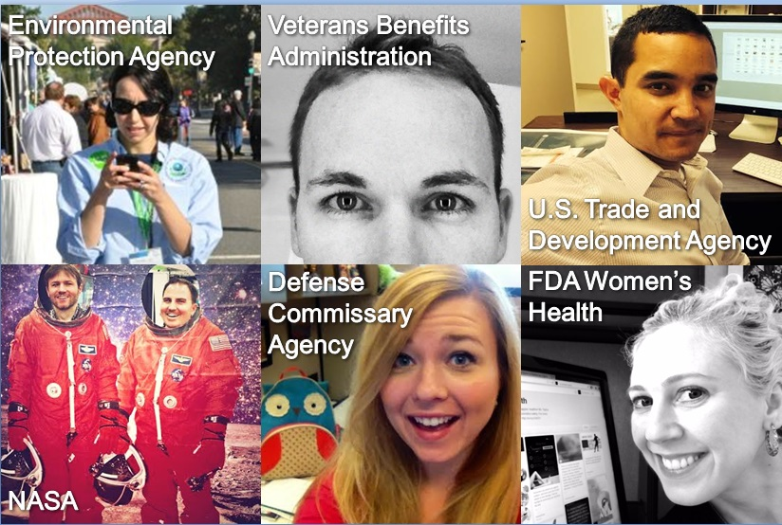
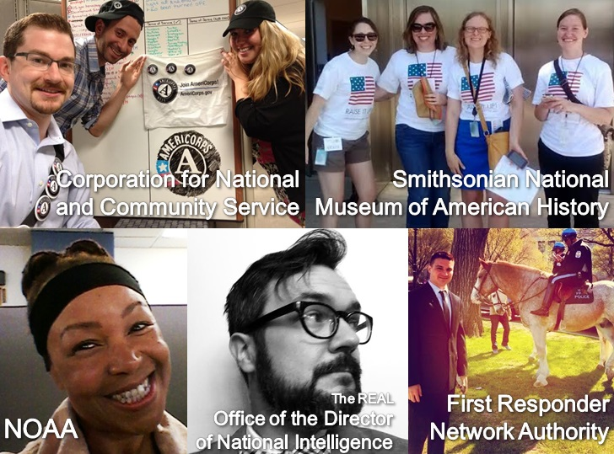
Federal Government Social Media & Data

Slide 15
Recommendations from SocialGov answer:
- How do we make it more Effective?
Performance measurement, data analysis
- How do we make it more Transparent?
Records keeping, archiving, strategy
- How do we make it more Accessible?
Plain language, transcription, multi-lingual, multi-platform

Slide 16
Directives SocialGov Commonly Adheres to :
OMB Guidance for Agency Use of Third-Party Websites/ Applications
Federal Records Act
Freedom of Information Act
Americans with Disabilities Act
Through inter-agency training, resource and toolkit development, guidance and consulting, the SocialGov program helps agencies in their individual efforts to comply with existing rules and regulations.

Slide 17
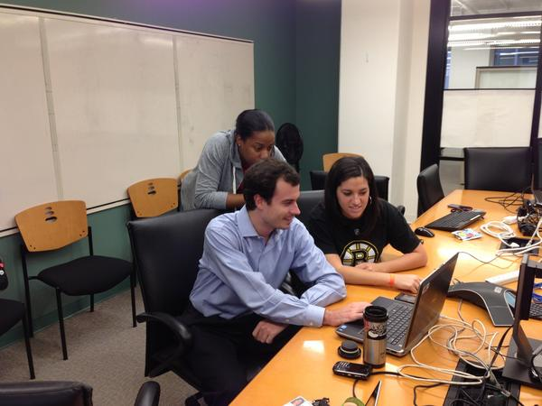
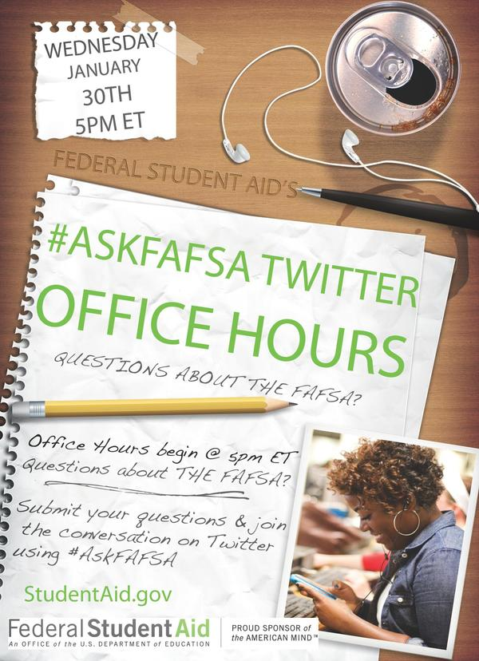

Slide 18
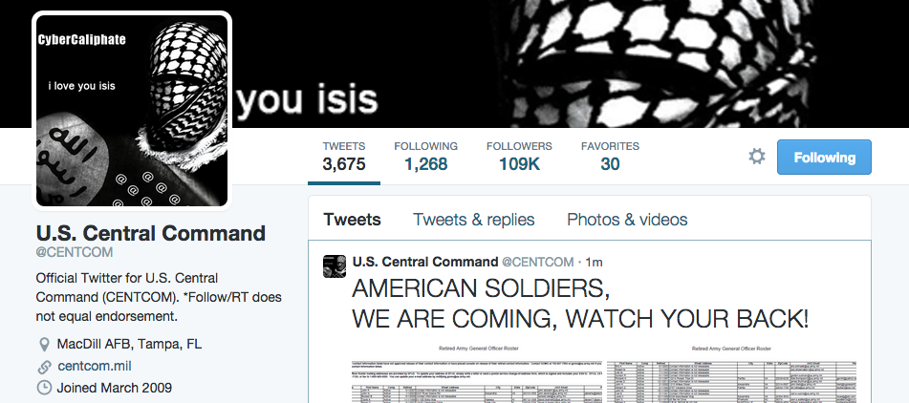

Slide 19

Confirm and Verify Changes to Access
Review account holders.
Confirm verification of login status.
Confirm changes and updates of passwords.
Conduct a review of lessons learned
What type of response worked well?
Why did this work so well?
What did not work?
What unforeseen events occurred?
What changes will lead to a better response?
Apply data and analysis of outcomes to improving your program

Slide 20
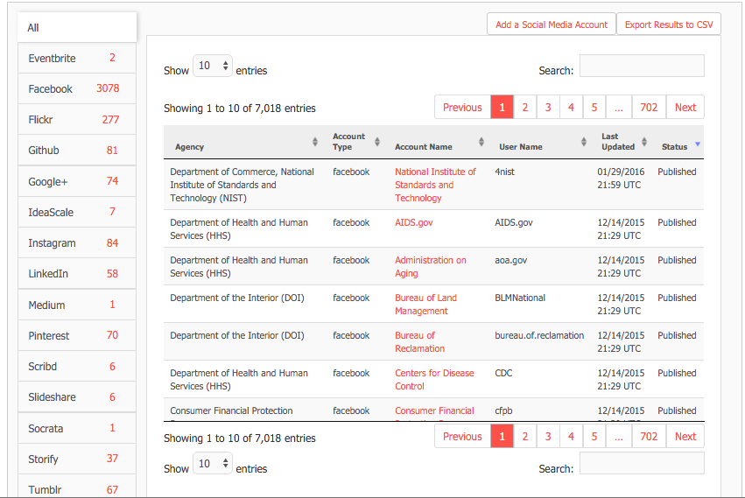

Slide 21


Slide 22


Slide 23
“the most important social media advancement in the U.S. government in four years…”
- ProgrammableWeb

Slide 24
“the biggest social media initiative ever”
TechCrunch reporter

Slide 25
“evolutionary step forward in open government”
- Harvard National Security Fellow

Slide 26
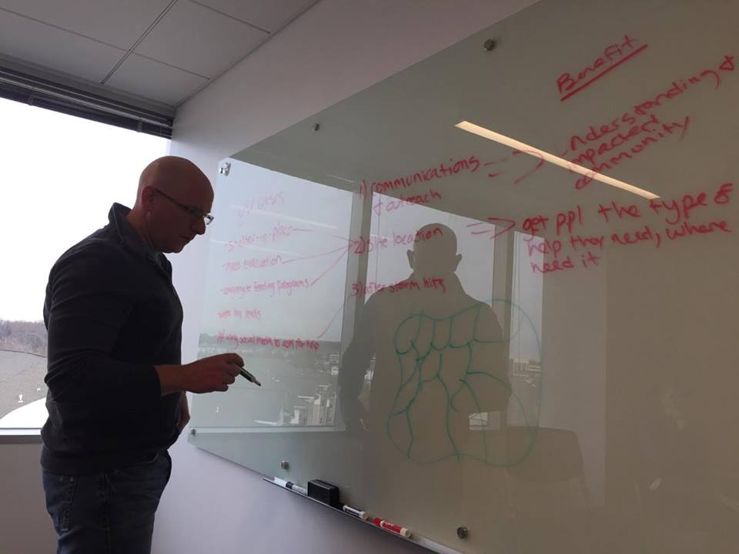

Slide 27
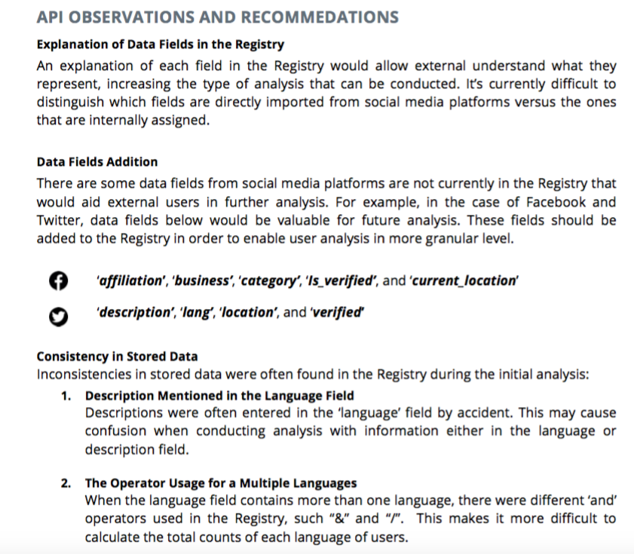

Slide 28
U.S. Digital Registry API uses in discussion:
Shared Records and Archiving of all engagement across the federal government
Shared Analytics of all engagement across the federal government
Integrated management platforms for niche services, like Emergency Management

Slide 29
Challenges

Slide 30
Challenges: Official Use of Social Media
Standards of Ethical Conduct (including):
-Impartial Treatment of Vendors & Users
-Endorsement
-Unauthorized Use
Records-Keeping
Appropriations
Contracts & Terms of Service
Paperwork Reduction Act
Federal Advisory Committee Act
Rehabilitation Act, 508 Accessibility Standards
Information Quality Act
Security
Information Protection (confidential/nonpublic)
Constitutional Issues (First Amendment)
Privacy & Privacy Act
Hatch Act
Anti-Lobbying Act
Agency Non-Endorsement
Branding & Public Relations
Intellectual Property
Lifecycle & Decommissioning Accounts

Slide 31
Challenges: Personal Use of Social Media
Standards of Ethical Conduct (including):
-Attribution
-Fundraising
-Endorsement
-On-duty Use (Limited & Acceptable Use)
Brand-Protection/Dilution
Security
Occupational Rules (Bar, Medical, etc…)
Constitutional Issues (First Amendment)
Information Protection (confidential/nonpublic)
Discipline based on evidence of misconduct related to the efficiency of the service:
Shannon v. VA, 2014 MSPB Lexis 3593 (2014)
Special Counsel v. Lewis, 2014 MSPB Lexis 3134 (2014)
Hunter v. Navy, 2011 MSPB Lexis 3159 (2011)
Vidal v. Army, 2011 MSPB Lexis 4788 (2011)

Slide 32
Addressing the Challenges
Establish Social Media Policies & Best Practices
Focus on Social Media in Ethics Training
Understand Application of the Standards of Conduct to Typical Social Media Use

Slide 33

Establish Social Media Policies & Best Practices
Establish comprehensive social media policies for official accounts: Ethics, Compliance, Pub. Rel., etc.
Consider whether to update “limited use” policies to address personal social media on Gov. time/property
Consider adding a social media “disclaimer” to official sites:
“This is an Official U.S. Government Account”
Contact OGE to determine whether a policy needs to be incorporated into a Supplemental Regulation. See OGE LA-11-07.
Retrieved from https://www.mcnc.org/policies

Slide 34
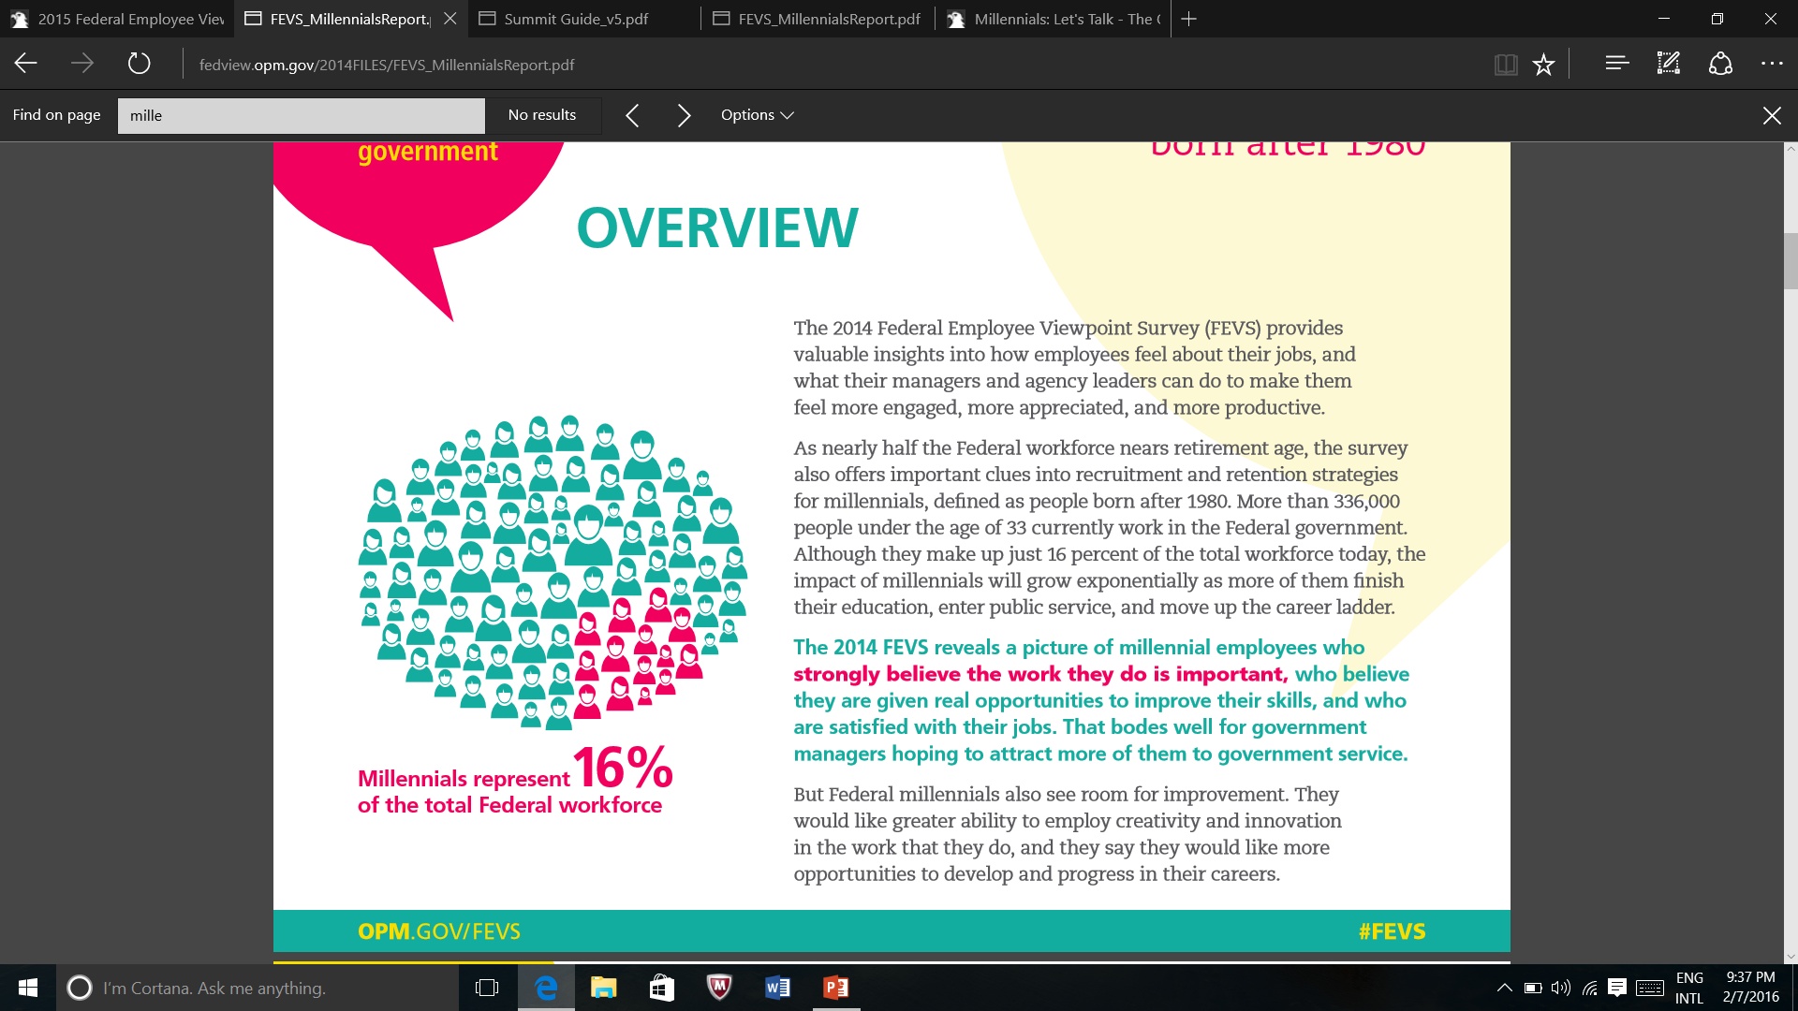
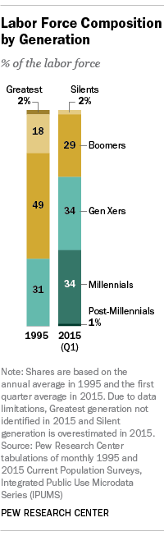
Focus on Social Media in Ethics Training
2014: 360,000 employees in the Federal workforce were millennials
- Largest growing sector of workforce
Social media ethics questions likely to become more prevalent
Set expectations during IEO
Focus on distinction between official and private identities and responsibilities
Easy to head off: “ounce of prevention worth a pound of cure”
OPM, Millennials: Finding Opportunity in Federal Service, available at http://www.fedview.opm.gov/2014FILES/FEVS_MillennialsReport.pdf
http://www.pewresearch.org/fact-tank/2015/05/11/millennials-surpass-gen-xers-as-the-largest-generation-in-u-s-labor-force/

Slide 35
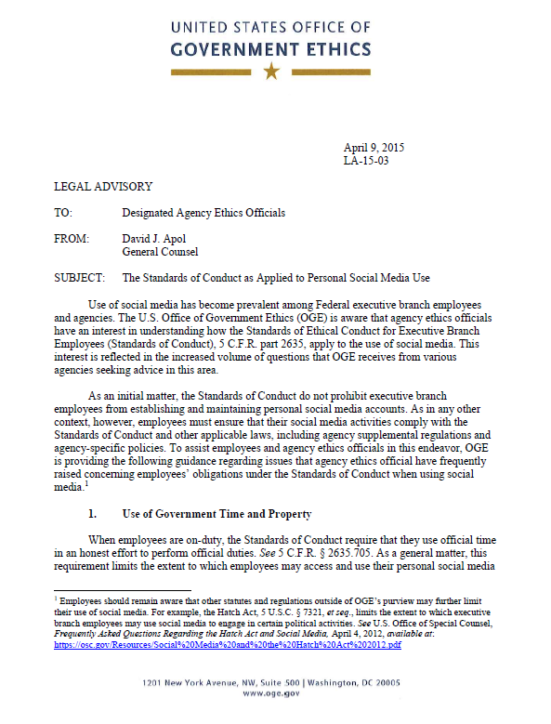
Understand How the Standards of Conduct
Apply to Social Media Use
LA-15-03: Standards of Ethical Conduct as Applied to Social Media
New Tools, Same Rules
Reinforces that SOC apply to Personal SM Conduct (not exempt; not held to different standards)
Establishes SOC/SM Framework
Addresses important code sections and sets out guidance, factors for analysis, and presumptions.
Focus on Attribution, Authorization & Accountability

Slide 36
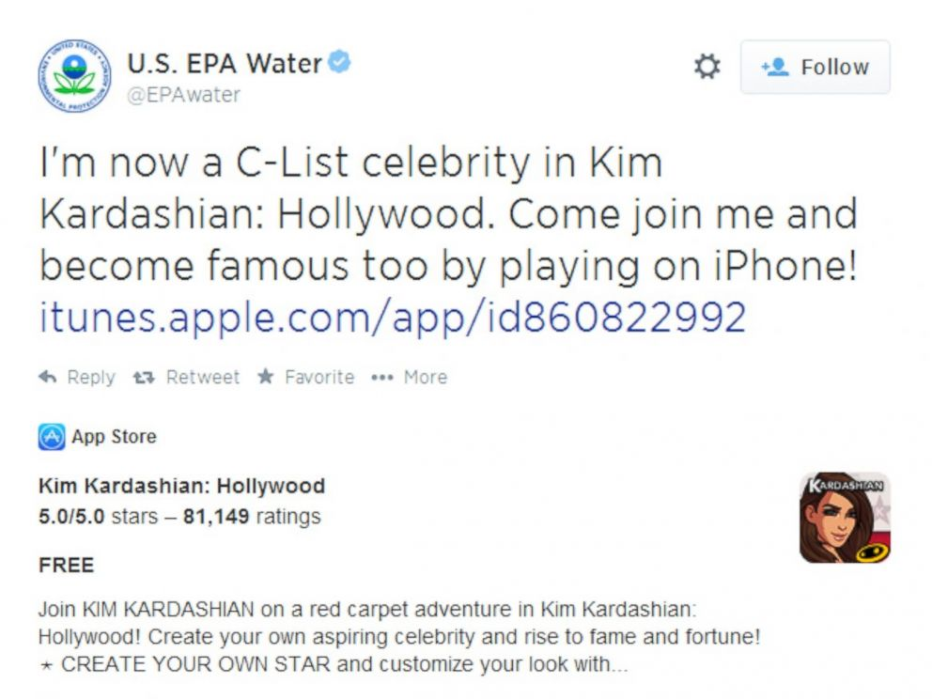
Official Government Social Media Accounts & Personal Use on Gov. Time
Official accounts are for official purposes
Employees have a duty to protect and conserve Government property and shall not use such property, or allow its use, for other than authorized purposes.
Employees shall use official time in an honest effort to perform official duties.
Employees may use computers and agency time for unofficial but authorized purposes if permitted under agency policy.
5 C.F.R. §§ 2635.704–705

Slide 37
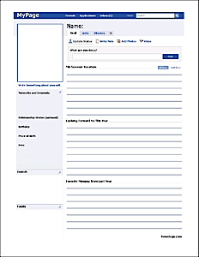

Reference to Government Title or Position on Personal Account
5 C.F.R. §§ 2635.702(a)-(c)
In evaluating whether a reference to an employee’s official title or position on social media violates the Standards of Conduct, the agency ethics official must consider the totality of the circumstances to determine whether a reasonable person with knowledge of the relevant facts would conclude that the government sanctions or endorses the communication. OGE LA-13-05
Job: Attorney at Federal Energy Regulatory Commission
School: MT Law School, MT Undergrad
Location: Lives in Arlington, VA
From: Helena, MT
Relationship: Married to John Smith
Just read the newest case on Electricity Rate Regulation. As a Lead Attorney at FERC, I know that this isn’t going to change our policy on X.
An employee does not . . . create the appearance of government sanction merely by identifying his or her official title or position in an area of the personal social media account designated for biographical information. OGE LA-15-03.

Slide 38

Seeking Outside Employment
Employees who are seeking or negotiating for employment through social media must comply with the Standards of Conduct & Criminal Law
An employee is not considered to be seeking employment with any person or organization merely because
the employee has posted a resume to the employee’s personal social media account.
a person or organization has viewed the employee’s resume on that social media account
a person or organization has sent an unsolicited message, including one containing a job offer, to the employee.
OGE LA-15-03; 5 C.F.R. 2635 Subpart F; 18 U.S.C. § 208
Retrieved from http://www.introprogramme.com/pages/index.asp?title=Graduate_Programmes_Belfast_Northern_Ireland_-_Intro_Programme_-_Graduates__-_Seeking_Employment

Slide 39

Personal Capacity Fundraising
Employees may use personal social media accounts to fundraise for nonprofit charitable organizations in a personal capacity, but:
May not personally solicit subordinates or known prohibited sources
May not use official title, position, or authority associated with position to advance fundraising effort.
5 C.F.R. § 2635.808(c)

Slide 40
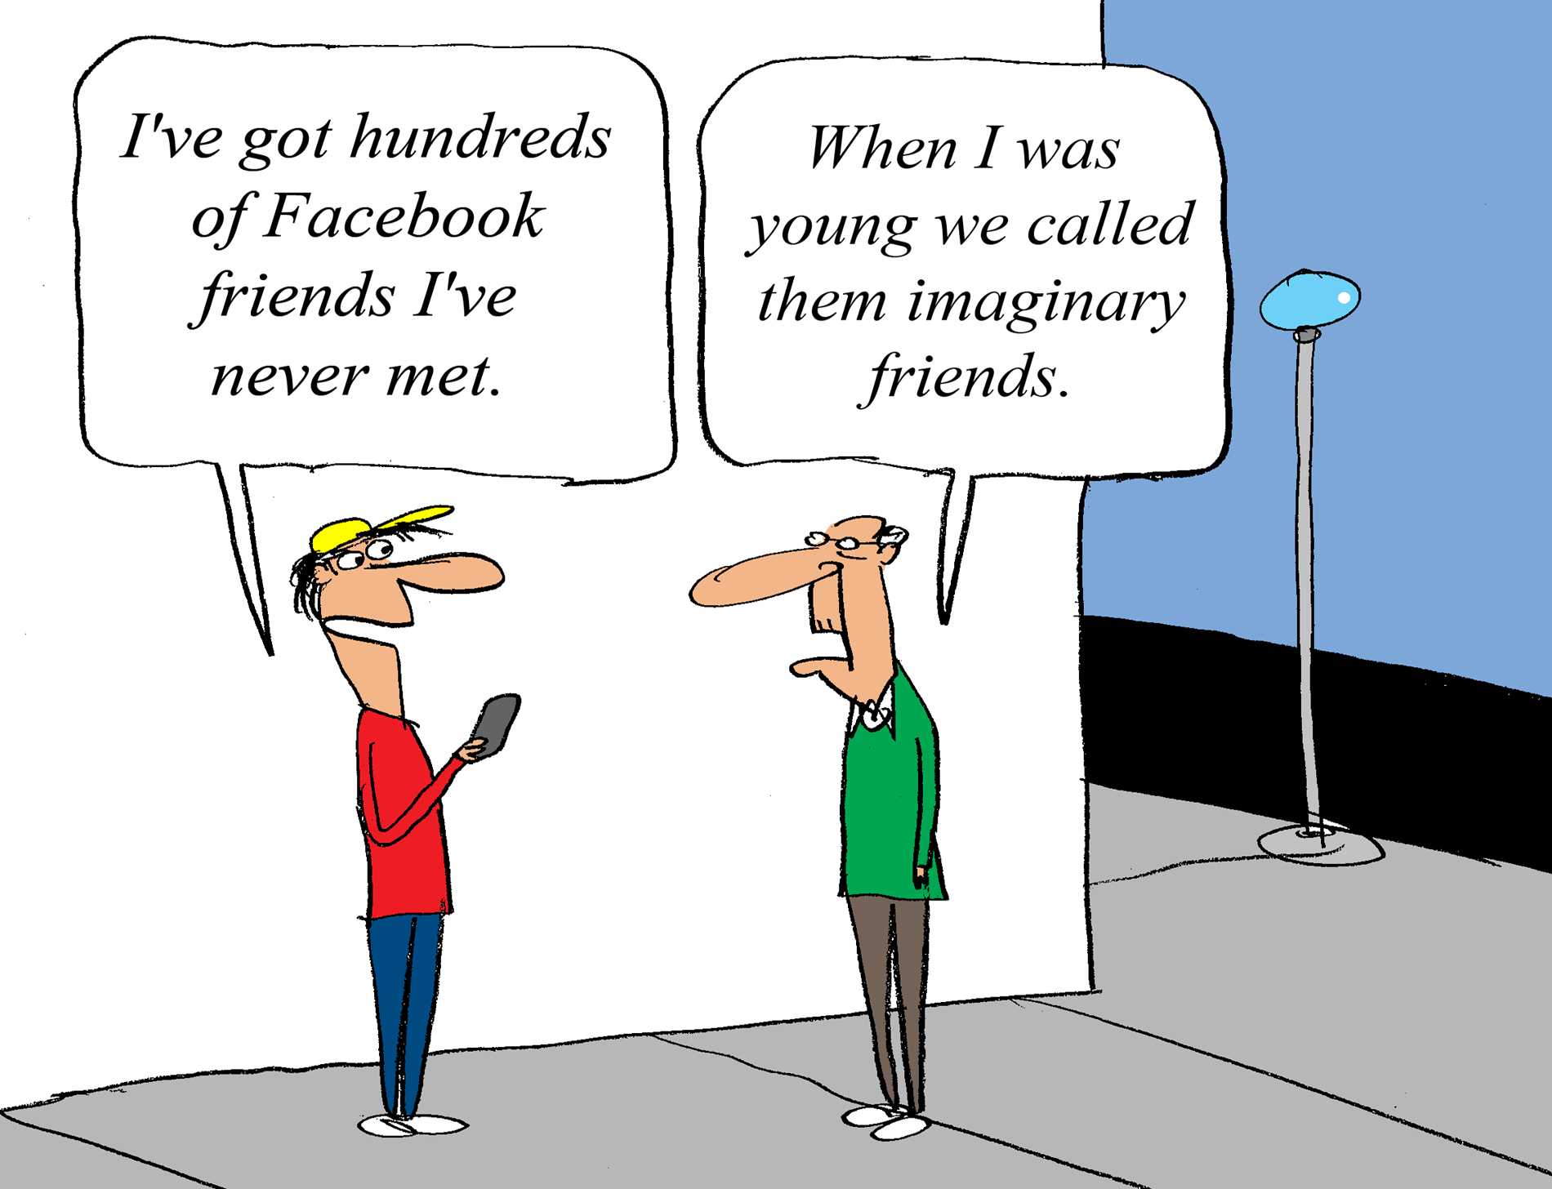
Personal Relationships with Social Media Contacts
5 C.F.R. 2635.204(b)- Personal Relationship Exception to the Gift Prohibition:
  An employee may accept a gift given under circumstances which make it clear that the gift is motivated by a family relationship or personal friendship rather than the position of the employee. Relevant factors in making such a determination include the history of the relationship and whether the family member or friend personally pays for the gift
When is a “Friend” a “Friend”?
Retrieved from http://www.facebook-friends.com/why-to-differentiate-facebook-friends-from-acquaintances/

Slide 41

Questions?

